Slide 1
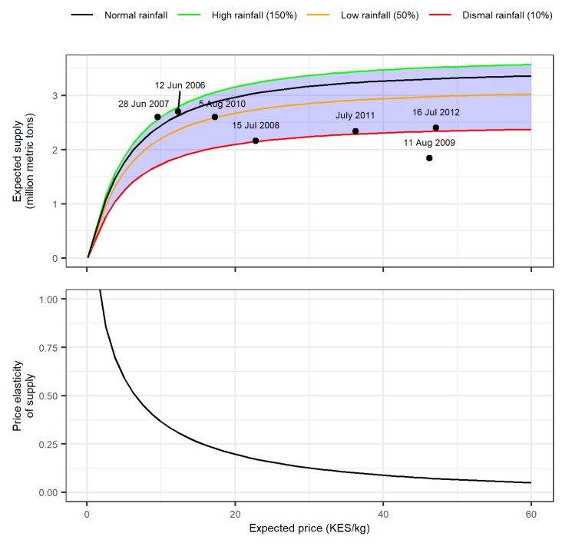
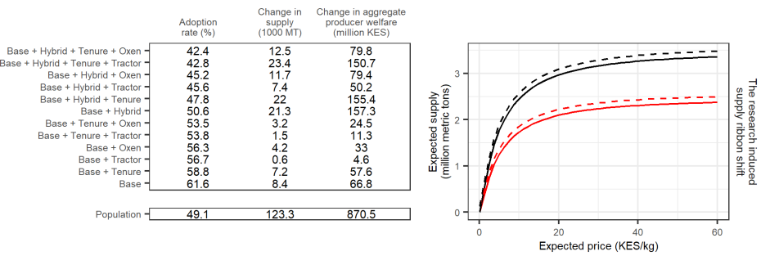

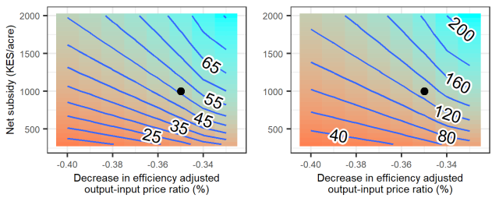
A theoretically derived model of agricultural supply curve/shifts
(The price elasticity of supply and adoption rate are endogenous to the model.)
The proposed model is derived from 5 non-controversial axioms and then fitted to Kenya maize farm data at different levels of expected rainfall (normal, high, low, and dismal); and vetted against empirical point estimates of aggregate supply.
A hypothetical technology shock is explored. Top: Impacts for a single price/subsidy assumption set disaggregated by TFP profile (e.g. base TFP + hybrid seed use + land tenure). Bottom: The aggregate impact plotted (black dot) on heatmaps covering a wide range of assumption sets to facilitate sensitivity analysis and policy discussion.

